Slide 1


Analysis of Project: Rewriting modules of sahibinden.com Android Mobile Application
Industrial Engineering Department
Blg448E Project Management In Engineering
Term Project

Slide 2

Our Team
Yunus Güngör – Student No: 150150701
Sadık Ekin Özbay – Student No: 150140104
D. Cem Karagöz – Student No: 150130066
Muratcan Şahin – Student No: 150130144

Slide 3
Our Connection
Berkay Aktan – Dicertor of Enginnering at Sahibinden.com
Mail:berkay.aktan@sahibinden.com
Sahibinden.com
Sahibinden Bilgi Teknolojileri Paz.ve Tic. A.Ş
Adress: Değirmen Yolu Cad. No:28 Asia OfisPark A Blok Kat:2 34752 Ataşehir/İstanbul Türkiye

Slide 4
Hierarchical Organization
Management Organization in sahibinden.com

Slide 5
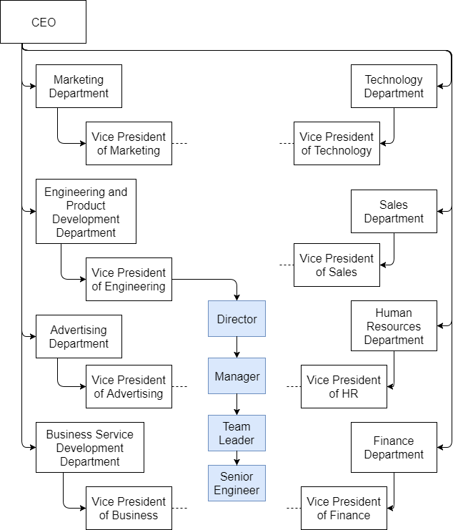
Sahibinden.com has 8 different departments
These departments have the same hierarchical structure
Only Engineering department's structure showed here

Slide 6
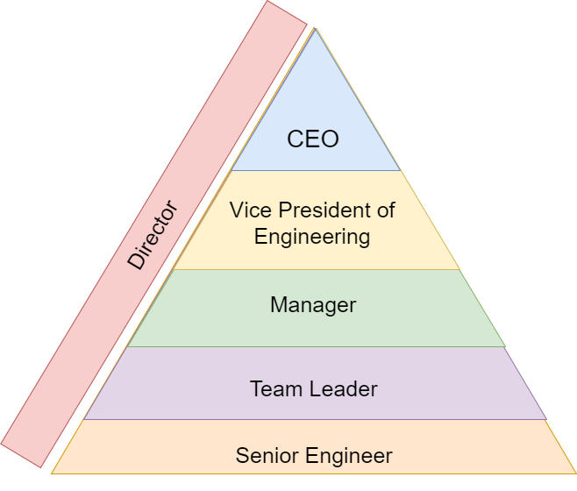
Notes:
Director acts as a sponsor and handle any contradiction in the projects
Each role has only one person to report and this connections explained later
But directors has direct informal Access to the all roles in company. (At least in this Project)
Most of the assignments, and resource management decisions happens with the approval of director and if there is a request from upper management director is notified

Slide 7
Each role report to only one person
Director acts as a project sponsor and has informal access to all other roles
Formal information stream formed as a line but informal information stream formed as a matrix
Notes:
Director acts as a sponsor and handle any contradiction in the projects
Each role has only one person to report and this connections explained later
But directors has direct informal Access to the all roles in company. (At least in this Project)
Most of the assignments, and resource management decisions happens with the approval of director and if there is a request from upper management director is notified

Slide 8

Project Management
Methods used in this project
Notes:
This project has been managed using agile management techniques
Rather than creating strict and binding schedules, agile techniques encourage flexible schedules to keep up with extreme flexibility of software industry.
This flexibity also applies to the rules and roles
team leader and senior engineers do the work
Director and manager handles with middle management

Slide 9

Most of the project managed through informal communications
Decisions made with meeting which everybody working on the projects attends
Reporting is as low as one per project after project finished
Notes:
Sometimes people from other departments also attends to the meeting to shape the product because it also affects them for example

Slide 10
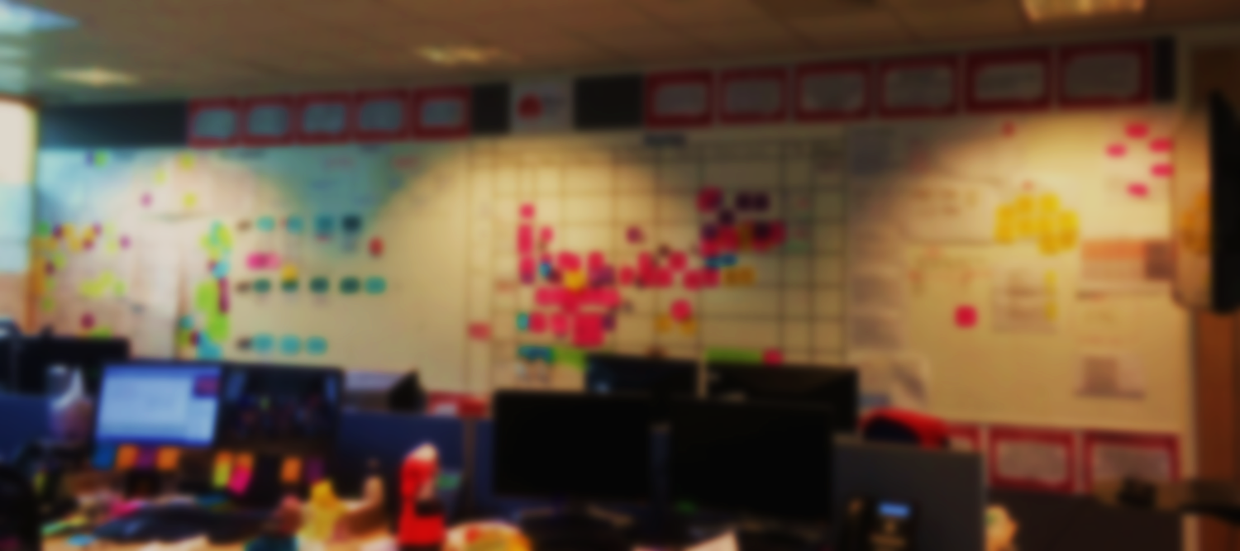

Kanban
Method
Notes:
Kanban Boards used in this method
After work packages determined with meeting and according to the experience
Boards with TO DO. DOING. TESTING. DONE columns used for tracking
Kanban method used for distributing tasks and scheduling

Slide 11

Project Metrics
How the project evaluated?

Slide 12

Metric | How to Evaluate | Importance
Traffic Volume | Is Increased? | High
Time Spent | Is Increased? Case by Case evaluation | Case by Case
Bug Count | Is Increased? | Medium
User Count | Is Increased? | Medium
Each metric is evaluated by itself than with the all other metrics
Metrics seen here is general metrics that used among many projects rather than specialised on one.

Slide 13

Traffic Changes
Any increases on the volume of traffic counted towards projects success. But if a certain module makes the app non user

Slide 14

Time Spent
Increased time spending is not nececarly a good thing and needs to be evaluated case by case. But most time increased total time is good for the project.

Slide 15

Bug Count
Increased bug count is always a bad thing amongs software projects. And we aim for lower bug count on each project that we shoulder.

Slide 16

User Count
After a deployment of the module we do not expect to see drastic increase of user count but after project finish we expect user increased more than usual.

Slide 17

Example: New Search Module
After the deployment of the new search module we monitor the spent time on the module and traffic volume that directed to the module. With this spesific module we expect that time spent on the module is smaller than before since we aim toward smaller time on search more time on general use at the app.

Slide 18

Example: New Home Page Module
After deployment of the new home page we expect to see increased traffic to our home page and other pages that connected to it. Also we expect that user spend more time on the home page if our module is well recieved.

